Slide 1
Coffee Shop Sales Analysis
A SQL-based Data Analysis Report

Slide 2
📌 Project Overview
This project analyzes a coffee shop's sales data using SQL.
The goal is to derive business insights, understand customer behavior, and optimize sales strategies.
The dataset includes transactions, product details, sales amounts, and timestamps.

Slide 3
🎯 Objectives
Identify key sales trends and revenue drivers
Analyze customer purchasing patterns
Determine peak sales hours and seasonal trends
Evaluate product performance and store efficiency
Extract insights for data-driven decision-making

Slide 4
❓ Key Business Questions Answered
Basic Questions
What is the total sales revenue?
How many transactions occurred in total?
What are the most frequently purchased products?
What are the different product categories available?
What is the average unit price of all products?
Which store location has the highest number of transactions?

Slide 5
Intermediate Questions
What is the total revenue generated per store location?
What are the top 5 best-selling products?
What is the average number of products purchased per transaction?
What is the sales distribution across different product categories?
Which time of the day has the highest number of transactions?
Advanced Questions
What are the peak sales hours for each store location?
How does the sales trend vary across different months?
What is the correlation between product price and quantity sold?
Are there any seasonal patterns in sales?
Which products have the highest revenue contribution across all stores?
Can we identify customer purchasing patterns based on time and location?

Slide 6

Total Sales Revenue
1. What is the total sales revenue?
SELECT round( sum(transaction_qty * unit_price),2)
AS total_sales_revenue
FROM coffee_shop;

Slide 7

Total Transactions
2. How many transactions occurred in total?
select
count(transaction_id)
as total_transactions
from coffee_shop;

Slide 8
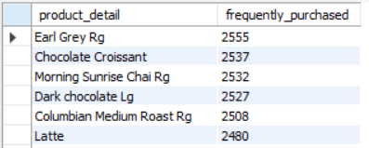
Most Frequently Purchased Products
3. What are the most frequently purchased products?
select
product_detail ,
count(transaction_id) as frequently_purchased
from coffee_shop
group by product_detail
order by frequently_purchased desc;

Slide 9
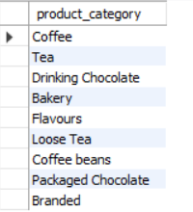
Available Product Categories
4. What are the different product categories available?
select distinct product_category
from coffee_shop;

Slide 10

Average Unit Price
5. What is the average unit price of all products?
select round(avg(unit_price),2)
as avg_unit_price
from coffee_shop;

Slide 11
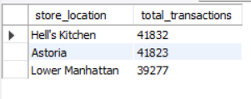
Store Location with Highest Transactions
6. Which store location has the highest number of transactions?
select store_location,
round(count(transaction_id),2)
as total_transactions from coffee_shop
group by store_location
order by total_transactions desc;

Slide 12
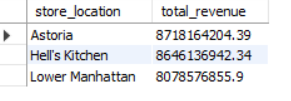
Total Revenue Per Store Location
7.What is the total revenue generated per store location?
select store_location,
round(sum(transaction_id * unit_price),2)
as total_revenue
from coffee_shop
group by store_location
order by total_revenue desc;

Slide 13
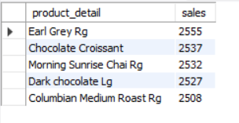
Best selling products
8.What are the top 5 best-selling products?
select product_detail,
count(transaction_id) as sales
from coffee_shop
group by product_detail
order by sales desc
limit 5;

Slide 14
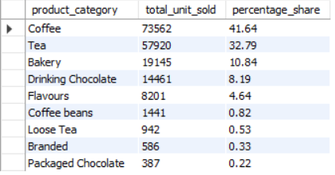
sales distribution by product categories
9.What is the sales distribution across different product categories?
select product_category,
sum(transaction_qty) as total_unit_sold,
round((sum(transaction_qty)*100 / (select sum(transaction_qty) from coffee_shop)),2) as percentage_share
from coffee_shop
group by product_category
order by total_unit_sold desc;

Slide 15

average products purchased per transaction
10.What is the average number of products purchased per transaction?
select
avg(transaction_qty) as avg_product_sold
from coffee_shop;

Slide 16
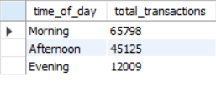
Highest transaction bt time
11.Which time of the day has the highest number of transactions?
SELECT
CASE
WHEN EXTRACT(HOUR FROM transaction_time) BETWEEN 6 AND 11 THEN 'Morning' WHEN EXTRACT(HOUR FROM transaction_time) BETWEEN 12 AND 17 THEN 'Afternoon' WHEN EXTRACT(HOUR FROM transaction_time) BETWEEN 18 AND 21 THEN 'Evening' ELSE 'Night'
END AS time_of_day,
COUNT(*) AS total_transactions
FROM coffee_shop
GROUP BY time_of_day
ORDER BY total_transactions DESC;

Slide 17
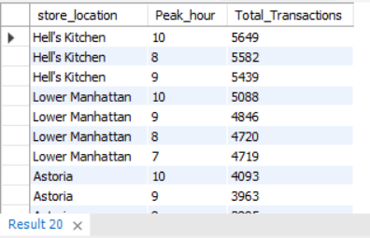
peak sales hours
12.What are the peak sales hours for each store location?
SELECT store_location,
EXTRACT(HOUR FROM transaction_time) AS Peak_hour, COUNT(*) AS Total_Transactions
FROM coffee_shop
GROUP BY store_location, Peak_hour
ORDER BY Total_Transactions DESC ;

Slide 18
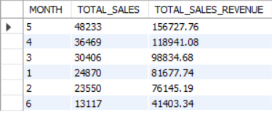
sales trend across months
13.How does the sales trend vary across different months?
SELECT
EXTRACT(MONTH FROM transaction_date) AS MONTH,
SUM(transaction_qty) AS TOTAL_SALES,
ROUND(SUM(transaction_qty * unit_price),2)
AS TOTAL_SALES_REVENUE
FROM coffee_shop
GROUP BY month
ORDER BY TOTAL_SALES DESC;

Slide 19
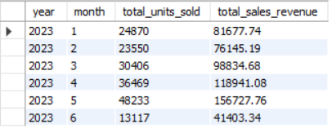
Sales trend by YEAR AND MONTH
SELECT
EXTRACT(YEAR FROM transaction_date) AS year,
EXTRACT(MONTH FROM transaction_date) AS month,
SUM(transaction_qty) AS total_units_sold,
ROUND(SUM(transaction_qty*unit_price),2) AS total_sales_revenue
FROM coffee_shop
GROUP BY year, month
ORDER BY year, month;

Slide 20

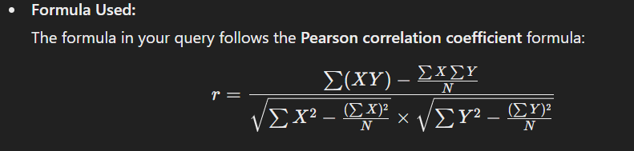
correlation
14.What is the correlation between product price and quantity sold?
SELECT
ROUND( (SUM(unit_price * transaction_qty) –
(SUM(unit_price) * SUM(transaction_qty) /
COUNT(*))) /
(SQRT(SUM(unit_price * unit_price) –
(SUM(unit_price) * SUM(unit_price) /COUNT(*))) *
SQRT(SUM(transaction_qty * transaction_qty) –
(SUM(transaction_qty) *
SUM(transaction_qty) / COUNT(*)))),4) AS price_quantity_correlation
FROM coffee_shop;

Slide 21
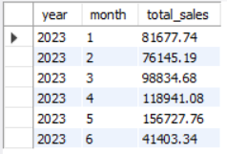
seasonal patterns
15.Are there any seasonal patterns in sales?
SELECT
EXTRACT(YEAR FROM transaction_date) AS year,
EXTRACT(MONTH FROM transaction_date) AS month,
ROUND(SUM(transaction_qty * unit_price),2) AS total_sales
FROM coffee_shop
GROUP BY year, month
ORDER BY year, month;

Slide 22
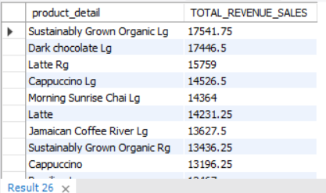
revenue contribution
16.Which products have the highest revenue contribution across all stores?
SELECT
product_detail,
ROUND(SUM(transaction_qty * unit_price),2)
AS TOTAL_REVENUE_SALES
FROM coffee_shop
GROUP BY product_detail
ORDER BY TOTAL_REVENUE_SALES DESC
LIMIT 10;

Slide 23
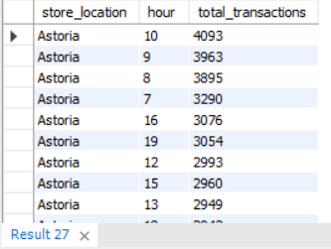
customer purchasing patterns
17.Can we identify customer purchasing patterns based on time and location?
SELECT
store_location,
EXTRACT(HOUR FROM transaction_time) AS hour,
COUNT(*) AS total_transactions
FROM coffee_shop
GROUP BY store_location, hour
ORDER BY store_location, total_transactions DESC;

Slide 24
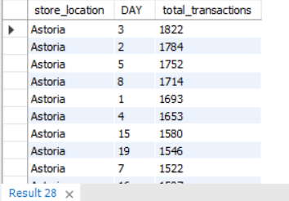
Peak Shopping Days
Finding Peak Shopping Days Per Store
SELECT
store_location,
EXTRACT(DAY FROM transaction_date) AS DAY,
COUNT(*) AS total_transactions
FROM coffee_shop
GROUP BY store_location, DAY
ORDER BY store_location, total_transactions DESC;

Slide 25
📌 Key Findings & Insights
Peak Sales Hours: Sales peak in the morning.
Bestselling Products: Earl Grey Tea and Chocolate Croissant had the highest purchase count.
Seasonal Trends: Sales increase during April and May.
Store Performance: The 'Astoria' location generated the highest revenue.
Revenue Drivers: High-priced items do not always have the highest sales volume.

Slide 26

✅ Conclusion
This project provided valuable insights into customer preferences, peak sales times, and product performance. The findings can help coffee shop owners make data-driven business decisions, such as optimizing inventory, pricing strategies, and marketing campaigns.

Slide 27
THANK YOU

